Slide 1
US Health Insurance
Team:
Le Dao
Dang Minh Nhu Nguyen
Nhung Luong
Class: MATH 161B - Spring 2022

Slide 2
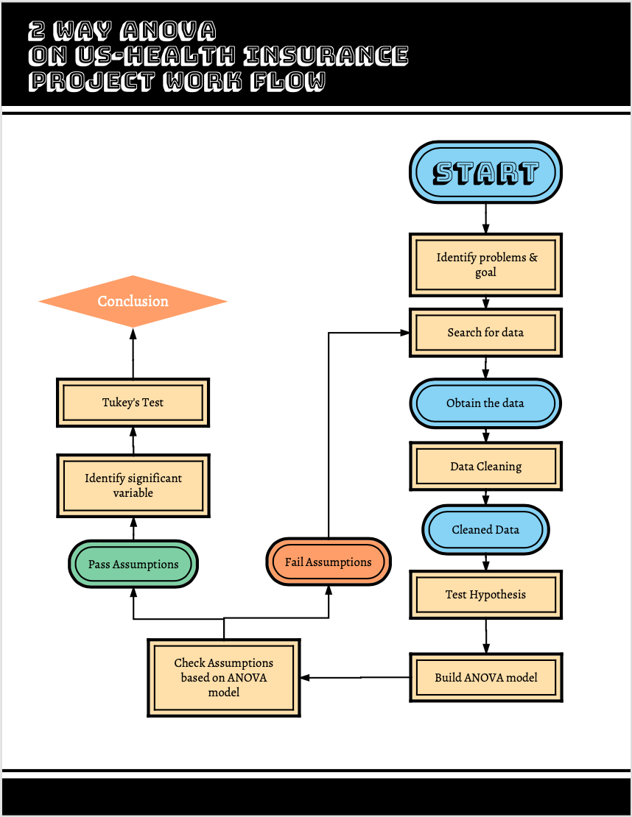
Outlines
Problem and Goal
Materials
Methodology
Result
Challenges and Future Improvement
Q&A
Notes:
Nhung
This is the flow chart we follow to work on this project.
At first, we will identify the problem that we’re interested in and decide the goal of the project
Next, we’ll search for the data that have information we need for analysis and do data cleaning.
We then state the hypotheses and build the model based on that. As you can see, we’ll use ANOVA in this project
After that, assumptions on normality, homogeneity, and independence are checked. If any of them fail, we go look for another dataset. If they all pass, and variables are found significant, Tukey’s test will be produced

Slide 3

Problem and Goal
Problem
Risk underwriting in Insurance Business
Variables in insurance charges (age, sex, smoker, etc.)
Goal
Answer: if there is an effect of number of children, smoker, and the interaction of both factors on insurance price
Notes:
As you all know, there are many factors that affect our health insurance price such as age, sex, or the location we live. Many of you may wonder why I‘m being charged by that amount but not lower. It turns out there is risk in health insurance that not many people notice. It is the risk of uncontrollable factors or an inaccurate assessment of risks when writing an insurance policy. It may result in paying out more than what we’re supposed to.
So, we would like to find out more about the effects of certain factors on insurance price. We picked out 2 factors that are most interesting to us. number of children, and tobacco use. We choose number of children to analyze because whether the plan covers dependents would make significant impacts on many people who have family

Slide 4


Materials
Dataset
Name: US Health Insurance Dataset
Source: Kaggle
Number of observations: 1338
Number of variables : Age, Sex, BMI, Number of Children, Smoker, and Region
Missing data: none
Programming language
R
3. Method:
2-way ANOVA
4. Selected parameters: 2 factors
Factor A: Number of children (Number)
Factor B: Smoker (Yes/No)
Notes:
Nhu:
After identifying the problem and goal for the project we start to search for dataset and the one we choose to complete this project is from Kaggle named US Health Insuarance Dataset with number of observation is 1338 and number of variables within the dataset is age, sex, BMI, number of children, smoker and region. There is no missing data on this dataset
We choose R to perform the ANOVA 2 way with the 2 factors are Number of children and smoker

Slide 5

Methodology
Data Cleaning:
Subset the data:
The number of observations in each group at different level of
factor A and B varied
Run for loop to randomly sampling 41 observations
Binding new data based on rows
→ Assure that each group have the same number of observations

Slide 6
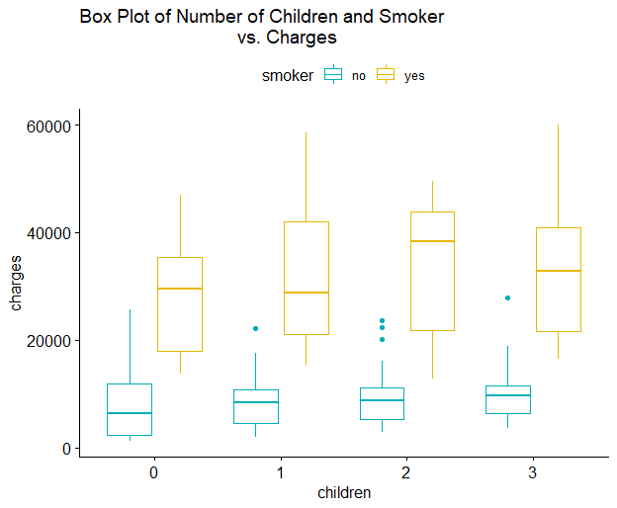
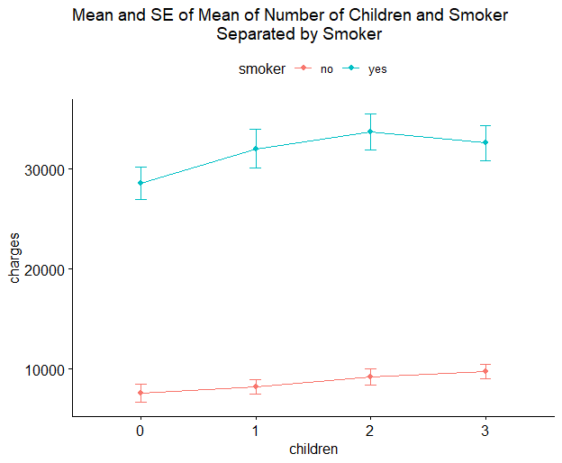
Methodology
Data Cleaning:
c. Visualize the data
Variance varied → Equal variances assumptions might be violated
However, ANOVA is fairly robust against this type of violations as long as the number of observations in each group has the same sample size (41 observations is chosen above)
Notes:
https://www.statology.org/equal-variance-assumption/

Slide 7
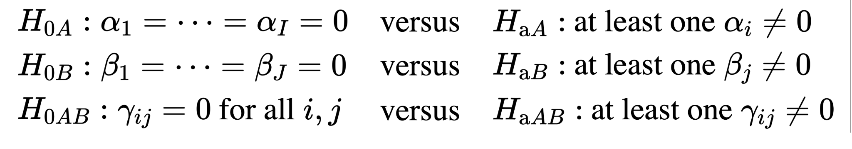
Methodology (Cont.)
2. Test Hypotheses:
H_{oA} states that the different levels of factor A (number of children) has no effect on the true average insurance price.
H_{aA} states that there is at least one level of factor A (number of children) has effect on the true average insurance price.
H_{oB} states that the different levels of factor B (smoker) has no effect on the true average insurance price.
H_{aB} states that there is at least one level of factor B (smoker) has effect on the true average insurance price.
H_{oAB} states that there is no interaction between the factor number of children at level i and factor smoker at level j.
H_{aAB} states that there is interaction between the factor number of children at level i and factor smoker at level j.
Notes:
Nhu:
We perform 3 hypotheses testing, first one is null hypothesis on factor A state that the different levels of factor A (number of children) has no effect on the true average insurance price versus the alternative there is at least one level of factor A (number of children) has effect on the true average insurance price. Repeat the same test for factor B (smoker) and the interaction between them

Slide 8
Methodology (Cont.)
3. Build ANOVA model
Responding variable: charges
Predictors: smoker, children and the interaction between the two features
4. Check Assumptions based on the ANOVA model:
Homogeneity of variance
Normality
Shapiro Test
Notes:
Le

Slide 9
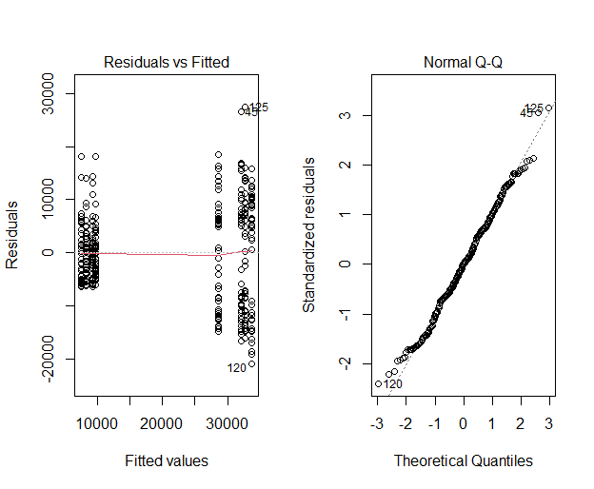

Methodology (Cont.)
Notes:
Le

Slide 10
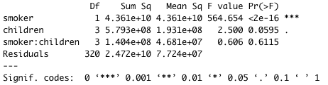
Result
5. Obtain the summary of ANOVA, identify the significant variable(s)
Fail to reject H_{oA,} the data suggests that there no is significant effect of number of children on insurance price.
Reject H_{oB}, the data suggests that there is significant effect of smoker on insurance price.
Fail to reject H_{oAB} , the data suggests that there no is significant effect of the interaction between smoker and number of children on insurance price.
ANOVA Summary of Test Result
Notes:
Nhu:
After making sure all assumptions are passed, the next step is obtaining the summary of ANOVA to identify the significant variables. From the ANOVA test result table, with the default threshold set to 0.05. The only p-value that is significant is smoker predictor.
Thus, we are reject the H0B, the data suggest that there is significant effect of smoker on insurance price

Slide 11

Result (Cont.)
6. Tukey’s Test
Tukey’s Test Result on Smoker
Notes:
Nhu:
Last step is performing Tukey Test to identify the significant difference between yes (smoker) versus non smoker. The result output showed the p-adjust value is really small which mean that there is significant difference between smoker and non smoker in the price charge of US health insurance

Slide 12
Challenges and Future Improvement
Challenges
Choose dataset and observational data
Test on different factors
Large enough and can be assumed as normally distributed
Need to pass assumptions Shapiro test
Improvement
MANOVA
Utilize all data in dataset
Better judgement
Notes:
Nhung

Slide 13
THANK YOU
Q&A

